Slide 1

Angular Best Practices
Himanshu Kumar (Premier Field Engineer)

Slide 2
Angular Best Practices | Agenda
Project and folder organization
Angular module organization
Component and services Best Practices
Important performance best practices
Notes:
After following these best practices you will be able to build respectable, high quality and scalable angular application.

Slide 3
File and Folder Structure
LIFT
L – Locate code fast
I – Identify code at a glance
F – Flattest structure possible
T – Try to be DRY (Don’t repeat yourself)

Slide 4
Agenda
Setting up our Development Environment
Getting started with Angular CLI
File Naming
Folder Structure
One Item per file

Slide 5
Setting up Dev Environment
Node version manager (nvm) (https://github.com/coreybutler/nvm-windows)
Angular CLI 6.2.7 (npm install –g @angular/cli@6.2.7)
Source map explorer (npm install –g source-map-explorer)
http-server (npm install http-server -g)

Slide 6
Getting Started with Angular CLI
Use Angular CLI to follow best practices by default
Angular team has put in lot of thought into it around code organization
So use Angular CLI to generate projects and different artifacts

Slide 7
Problematic Code
Lets look at some code which does not follow best practices
Problems:
Just by looking at file name we cannot determine what’s in it
Courses component should have a business specific name
File names should have
A descriptor (business specific name)
Followed by the type of file (component for component, service for service etc)
Notes:
All these rules get followed by default when you use Angular CLI.

Slide 8
Better Code
Lets look at the same application generated using Angular CLI

Slide 9
Problems with folder structure
We have our code organized into folders of specific type:
Components in components folder
Services in services folder etc
But this is not scalable
If we were to have multiple modules (accounts, finance, marketing etc)
Multiple teams also won’t be able to collaborate well with this structure since they have to work on multiple features parallely

Slide 10
General Coding Best Practices
Single Responsibility Principle
Symbol naming
Preferring immutability
Using small functions

Slide 11
Single Responsibility Principle
A single class or module should have single responsibility
Order –
NotifyCustomer
ReserveInventory
MakePayment
Point of sale system
DataRepositoryService has taken too many responsibilities

Slide 12
Symbol naming
Symbols should have meaningful and business specific names
Loading-Spinner component
File is named consistently
Class is not named consistently – Should have been Loading-SpinnerComponent
Constants should be named in camel case
Third party and system imports should be first
Application specific imports should follow TP and system imports

Slide 13
Immutability
Immutability is a good practice in JavaScript
Immutability means to not mutate or change the objects in memory
Immutability helps to avoid bugs such as bugs which arise when a value is changed somewhere else in code
Lets look at some bad practice in our code

Slide 14
Immutability bad practice example 1
Lets look at “enroll” method in data-repository service
When a user enrolls into a class the code is mutating objects in two ways:
Adding a class ID to classes array
Changing the “classes” array of currentUser object
To make it immutable use “Object.assign” like below:

Slide 15
Immutability bad practice example 2
Lets look at the “saveUser” function in data-repository
Here we are assigning the passed-in “user” object to “currentUser” object
If the calling method was to change the passed-in parameter then the “currentUser” property for the whole application will get updated
This will create very hard to find bugs
This will also not work well with on push change detection strategy

Slide 16
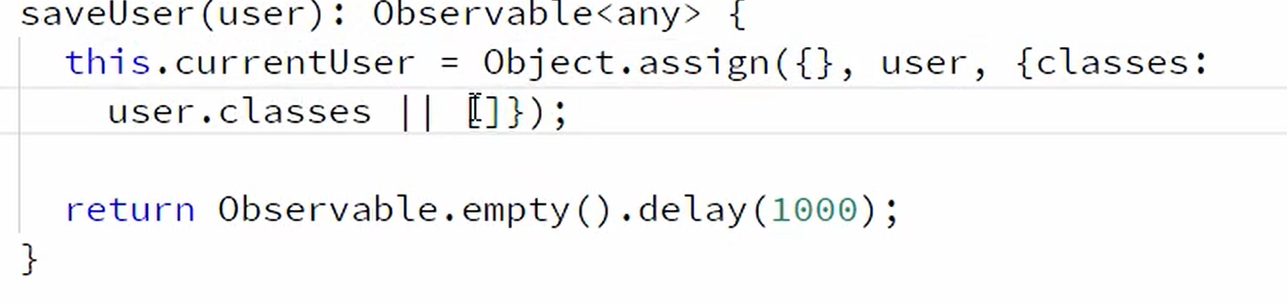
Immutability bad practice example 2
We should fix it like below:

Slide 17
Small Functions
If you find yourself writing a function with more than 10 lines
Try to break it to multiple functions

Slide 18
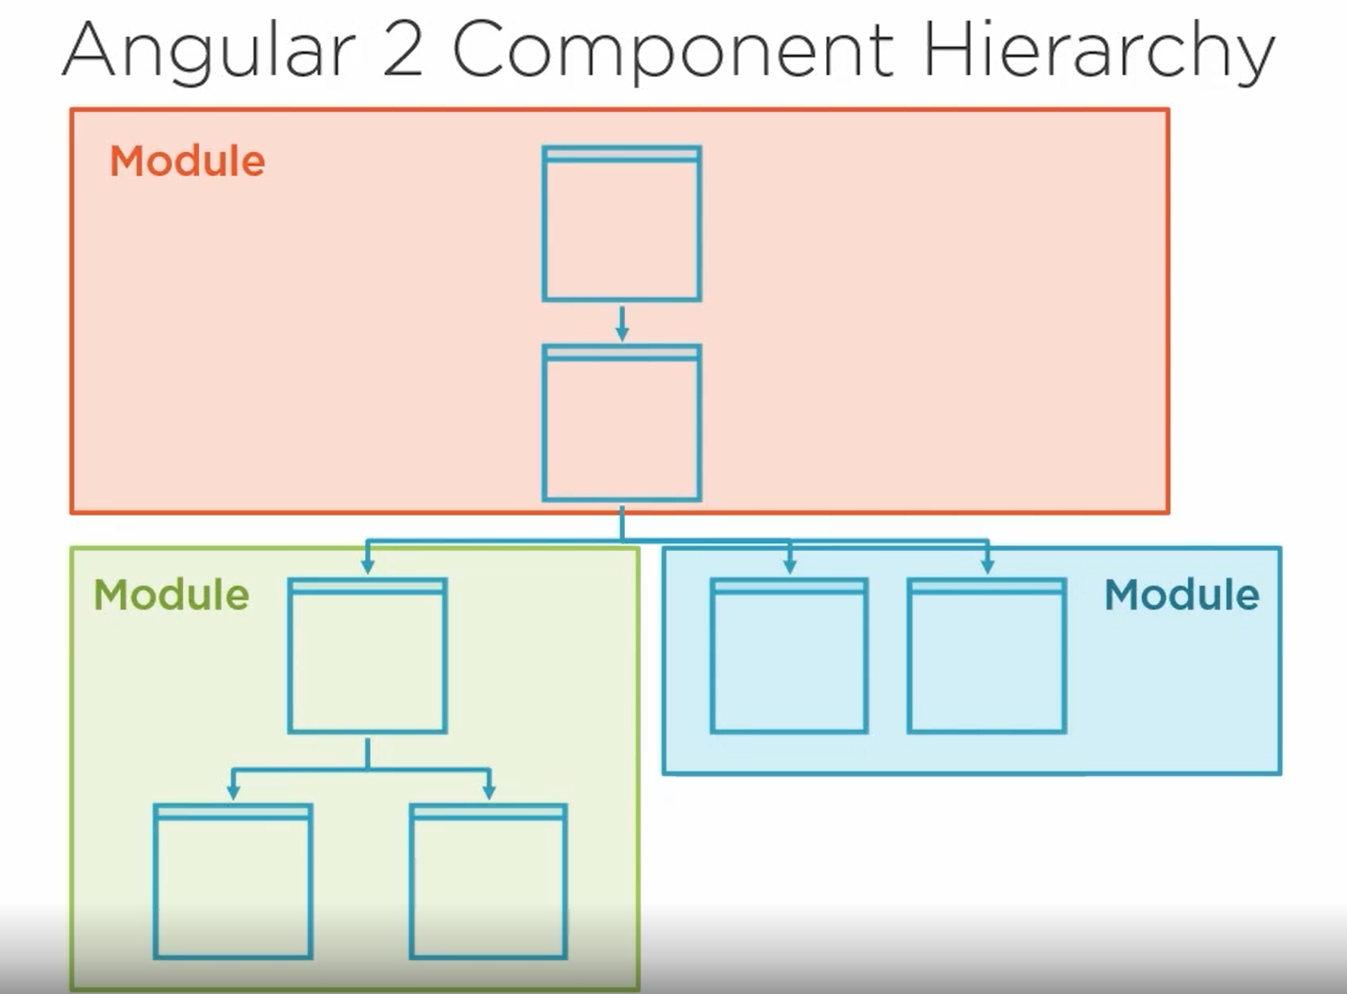
Module Organization
Core Module
Shared Module
Feature Module
Notes:
An angular application is just a hierarchy of components. So its better to break the components up in different module(s) wherein one could be
Core Module
Shared Module
Feature Module
Feature modules can be lazily loaded which enhance the performance of the application.

Slide 19
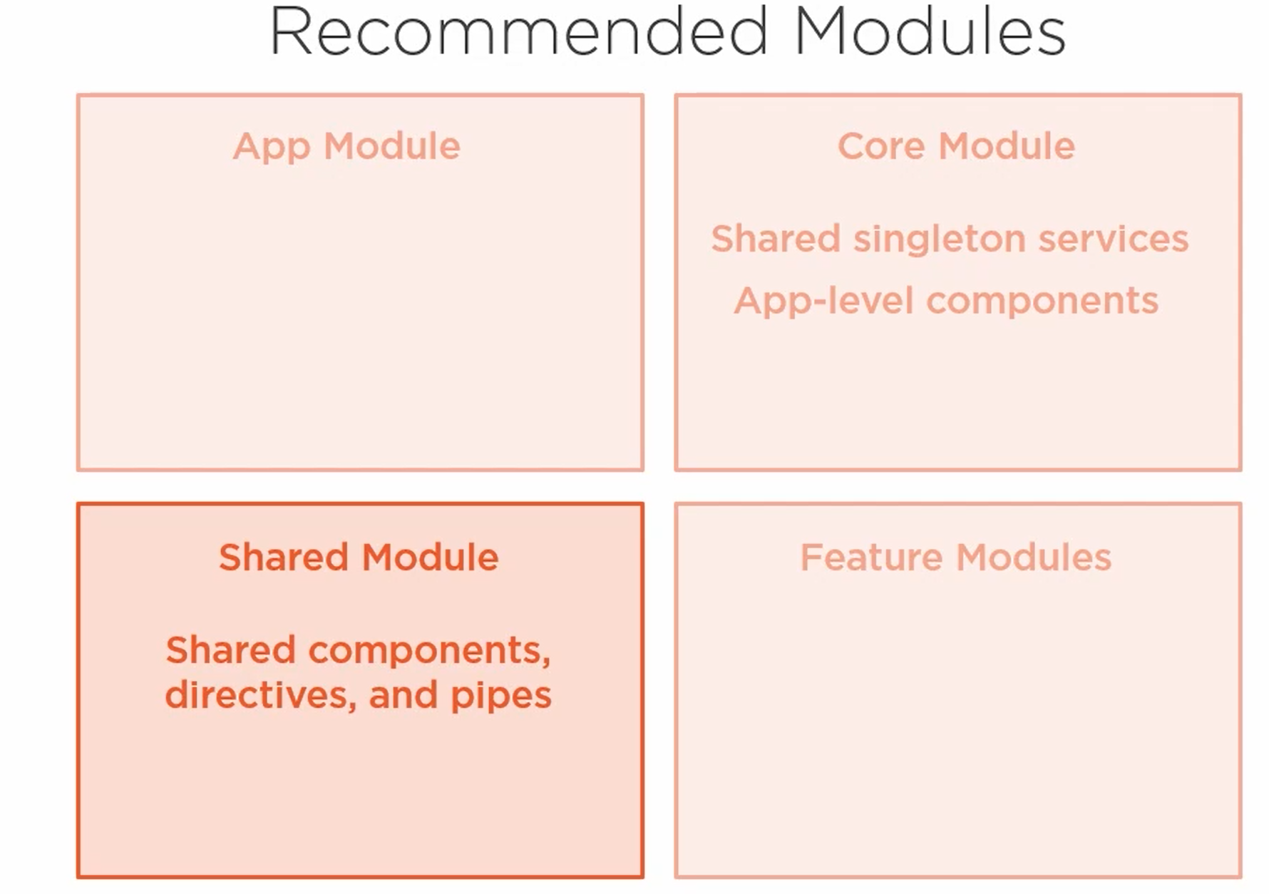
Notes:
App level component – Top navigation bar
Generally app developers keep app level components in app module itself which is not recommended by Angular.

Slide 20
Angular Component Best Practices
Prefixing Component Selectors
Using separate CSS and template files
Decorating input and output properties
Delegating complex logic to services
Component member sequence
Implementing lifecycle hook interfaces
When to create components

Slide 21
Prefix Component Selector
It’s a good idea to add a app/business specific prefix to the name of the component selector
Prefixing avoids conflicts if you happen to import another module having similar selector
For example: nav-bar | contoso-nav-bar
Prefixes should be 2 to 4 character short

Slide 22
Separate CSS and Template Files
This best practice gets followed automatically if you are using Angular CLI
Angular CLI automatically creates separate files for CSS and Templates to put in CSS and HTML
But if you end up manually creating components please follow this best practice

Slide 23
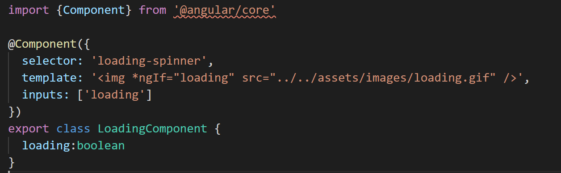
Decorating input/output properties
Notes:
Do you see problems here with respect to input property ‘loading’?

Slide 24
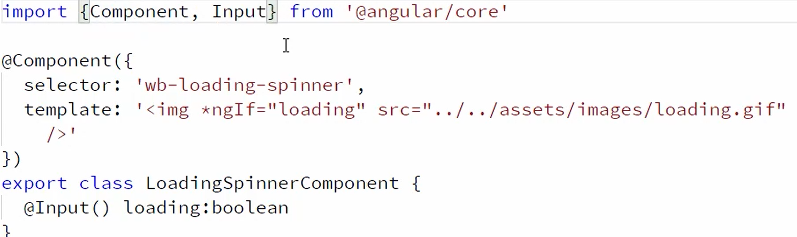
Decorating input/output properties
If you have to change the name of the property you have to do it at two places
Also this is not recommended by Angular

Slide 25
Delegating complex logic to services
This best practice is pretty simple
If the logic you are doing on some user action is simple enough like 1 or 2 lines then
Keep it in component
Otherwise move it in a service

Slide 26
Component member sequence
Put component properties at the very top in the component
Don’t intermingle properties with member methods
Put public members before private members

Slide 27
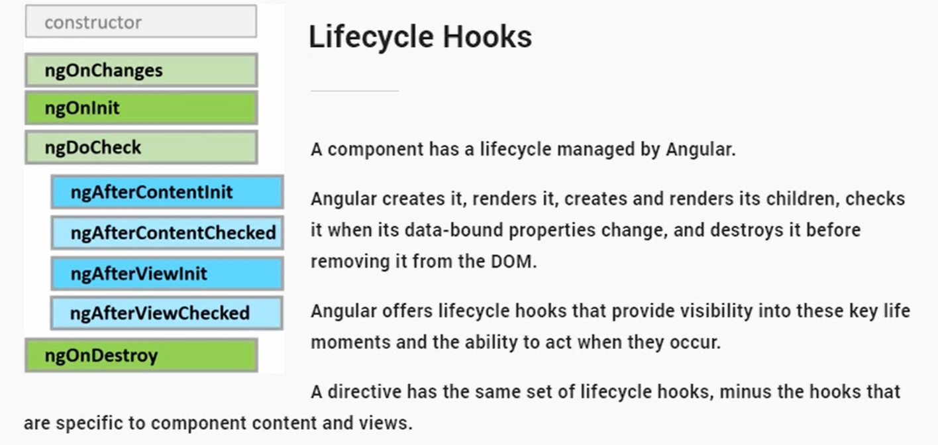
Lifecycle hook interfaces

Slide 28
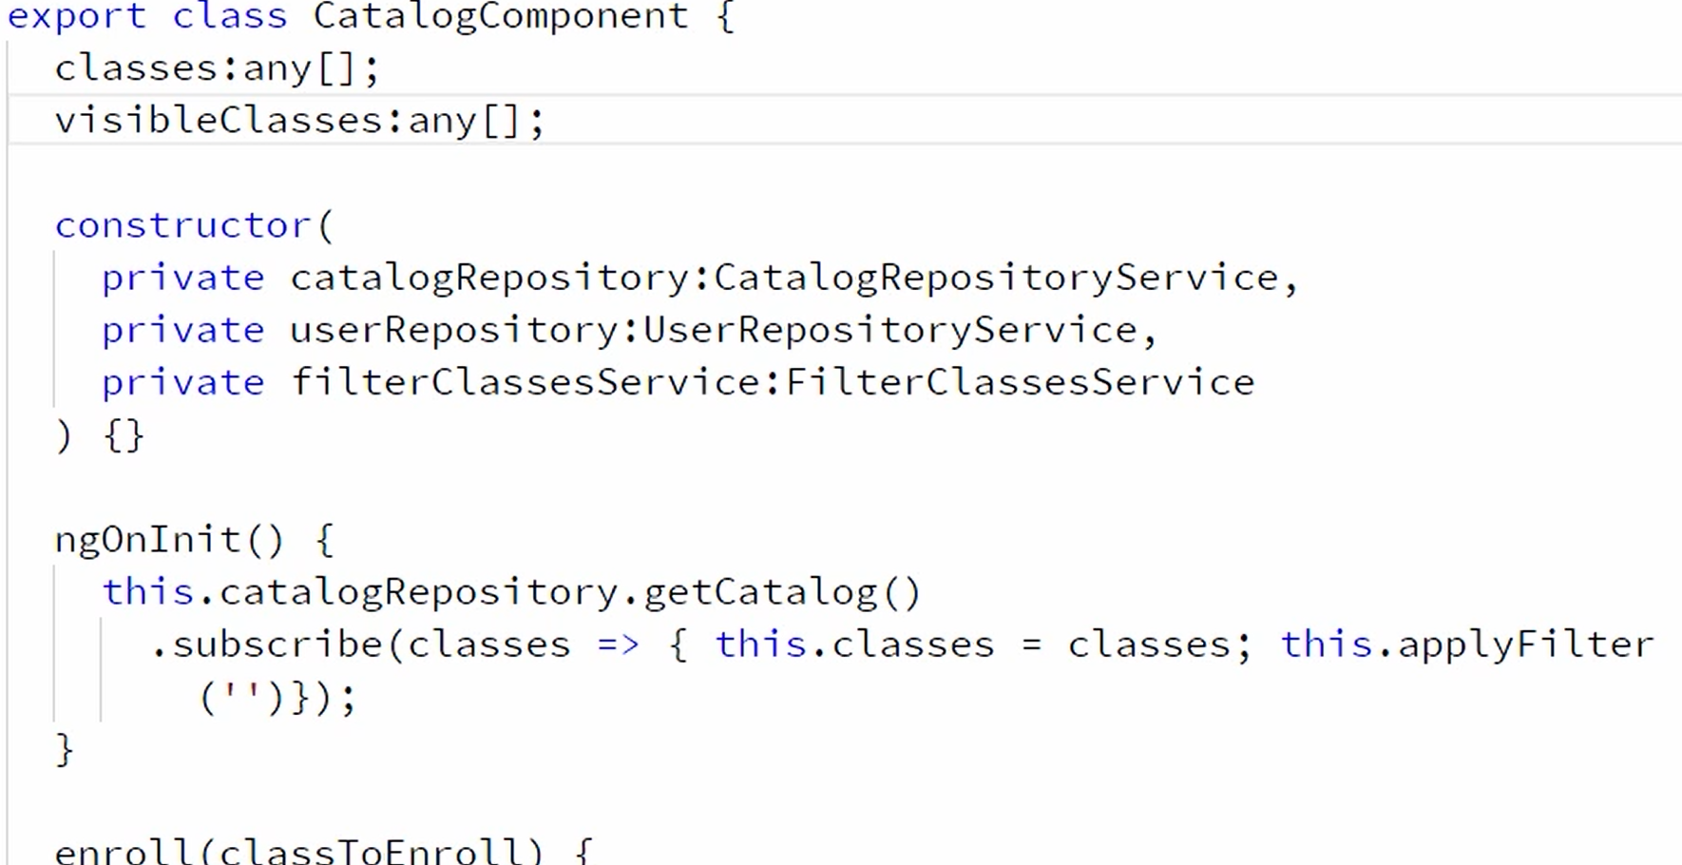
Lifecycle hook interfaces

Slide 29
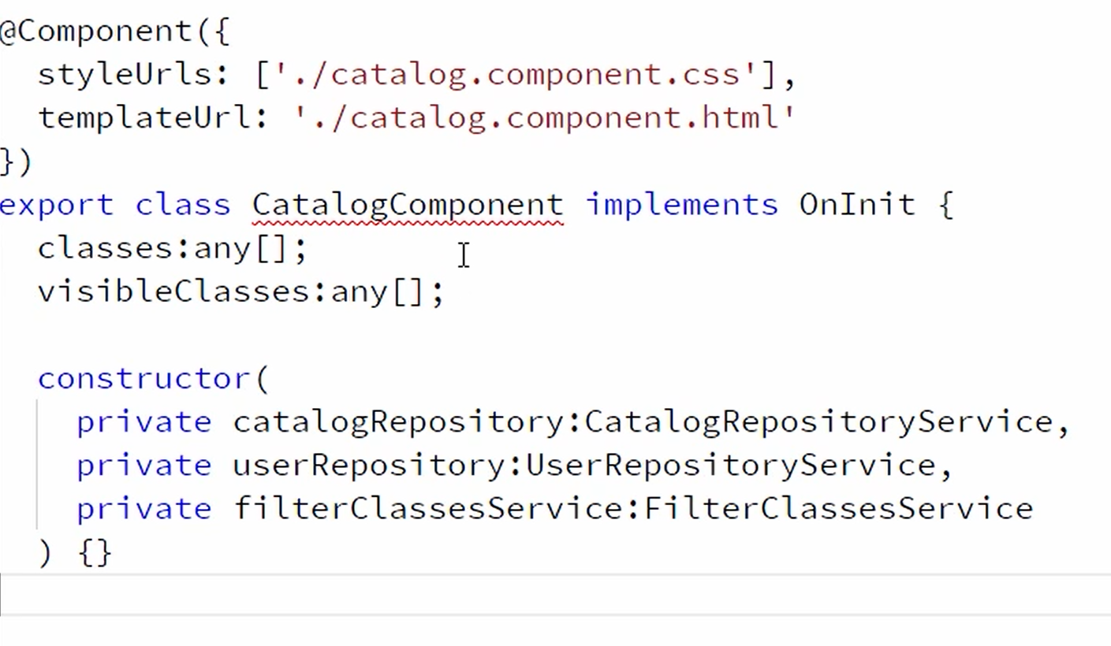
Lifecycle hook interfaces
Notes:
So the idea is don’t implement the lifecycle hooks without implementing the interface. With interface implemented VS code or any good editor is able to show you errors if you don’t implement it or if you implement it incorrectly for example with wrong parameter type etc.

Slide 30
When to (not to) create components
Never wrap a component with too many input properties into another custom angular component
If you do | You will have to expose all the properties again as input properties for the consumers to be able to use
For example: never wrap vanilla HTML elements like text box or buttons into a custom angular component

Slide 31
Services Best Practices
Marking services as injectable
Using services for data retrieval
Working with the Angular injector

Slide 32
Marking services injectable
When is @Injectable attribute required on service?
Always decorate services with @Injectable
Notes:
Always decorate services with @Injectable attribute because you never know when you would start injecting dependencies into it.

Slide 33
Using services for data retrieval
Never code data retrieval from an endpoint directly in a component
Delegate the data retrieval task to a service

Slide 34
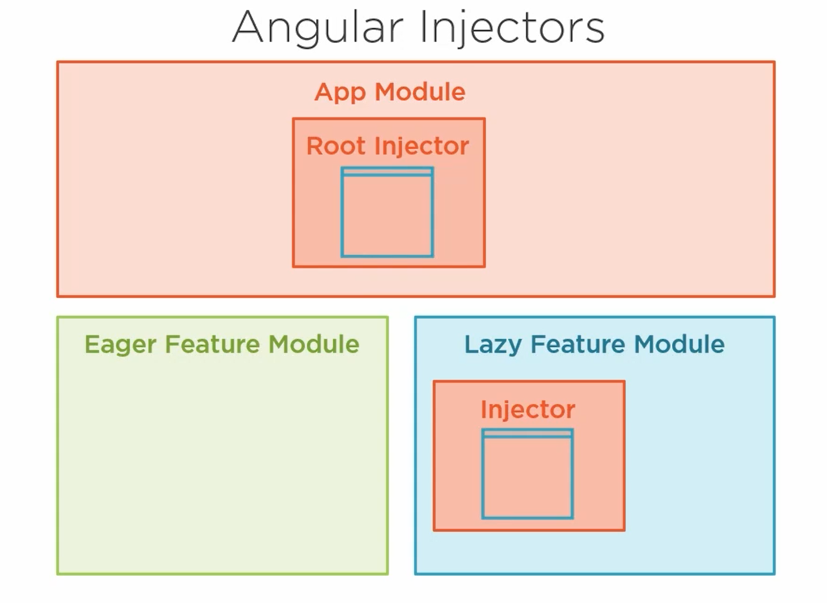
Working with Angular Injector
Notes:
For lazily loaded modules Angular creates its own injector and any service provided in it will be available to it only.
So imagine what will happen if you provided a service like UserService in it which holds the currently logged in user. It will be out of sync with the root injector. So it’s a good idea to create a core module and provide the common service through that.

Slide 35
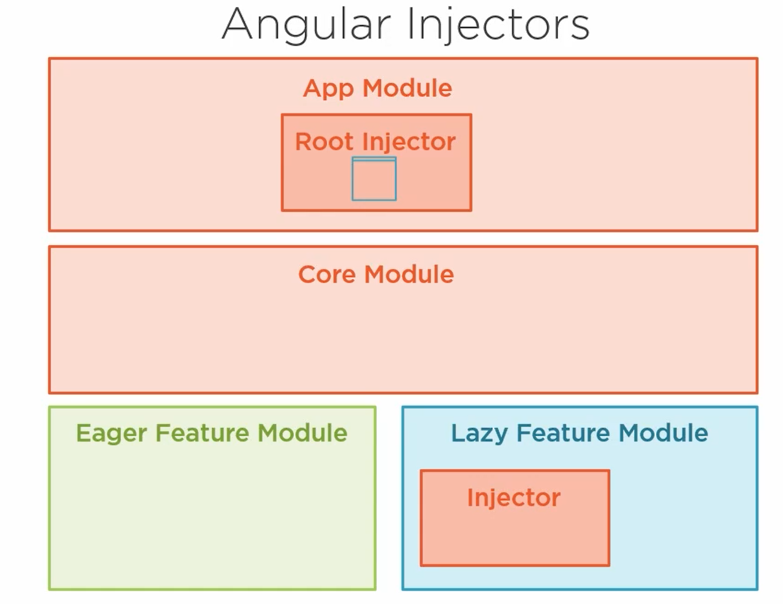
Working with Angular Injector

Slide 36
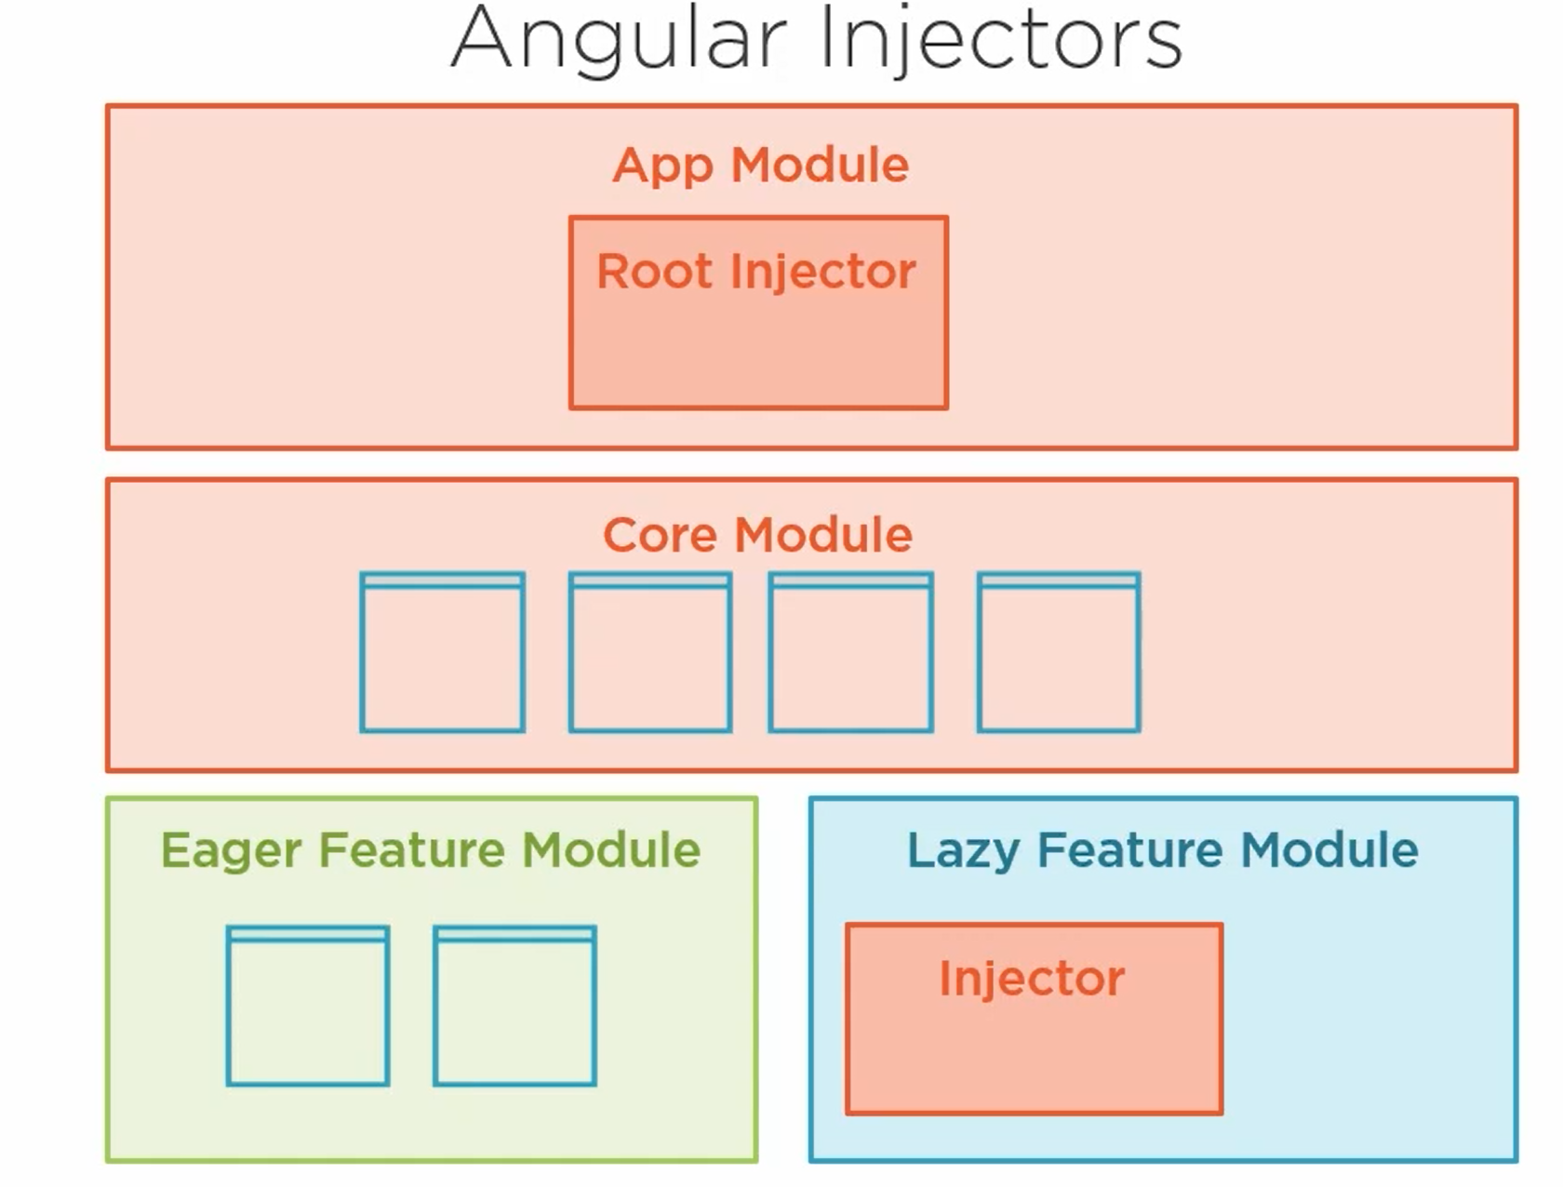
Working with Angular Injector
Notes:
You might ask why not just inject all the services in core module. Well its always good from code organizational perspective to keep service belonging to a module in that modules folder only.

Slide 37
Performance Best Practices
Ahead of time compilation and the CLI
Lazy loading feature modules
Paying attention to bundle sizes

Slide 38
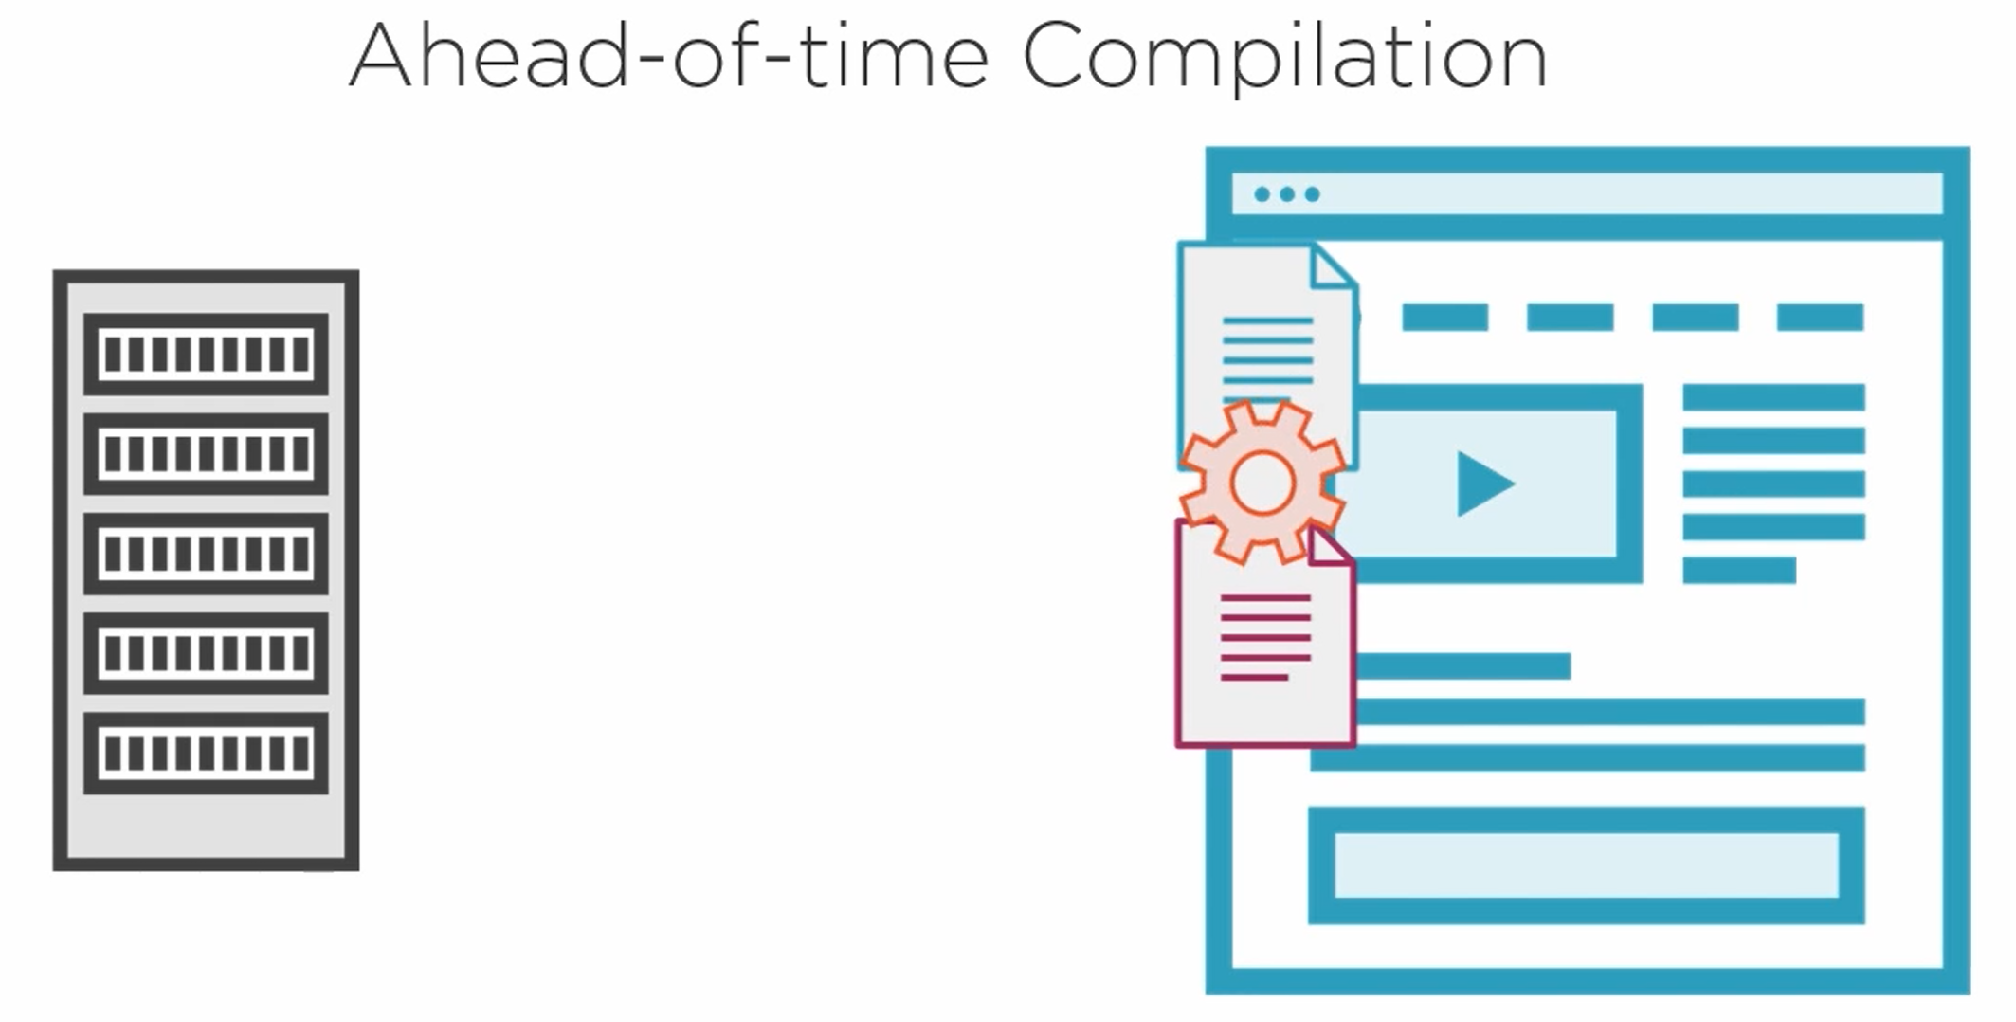
Without AOT compilation

Slide 39
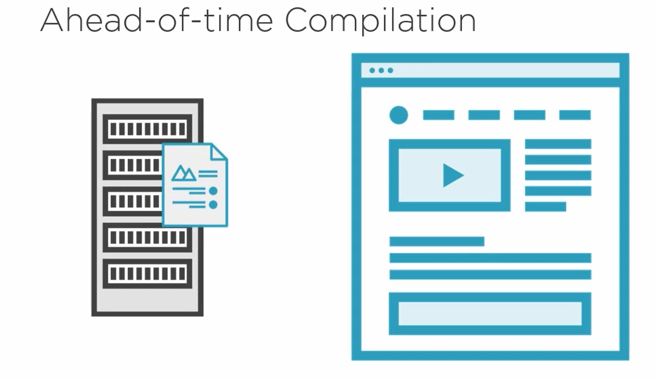
With AOT Compilation

Slide 40
Lazy load feature module
Lazy loading feature module does not load them when app module is loaded
They are loaded when route specific to them is hit
Lazy loaded modules are also chunked separately

Slide 41
OnPush change detection
Change detection cycle fires whenever there is a user action on the component
It checks for each binding on the component to see if value has changed
It can be costly sometimes if binding are complex expressions

Slide 42
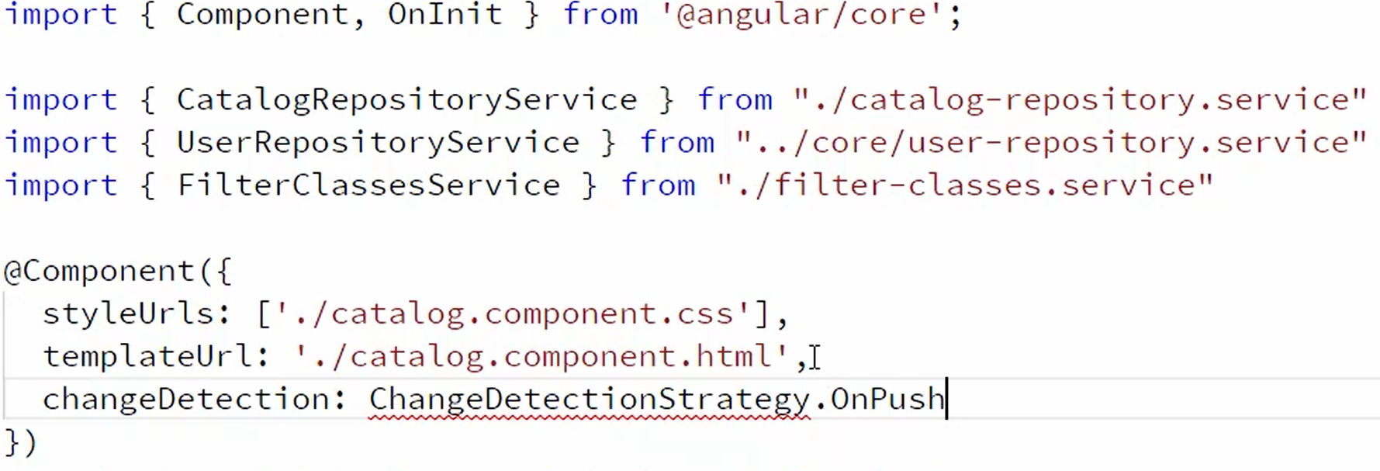
OnPush change detection

Slide 43
OnPush change detection
Should be used carefully
It can cause some hard to find/fix bugs

